Slide 1
overlapping block Spiking Transformer with Spatial-Temporal Attention
(obSTAtten)
Brandon Esebag

Slide 2
1. Introduction

Slide 3

Link to GitHub Repository
Contains a readme file, LaTeX code, project code, this presentation and all trained data used in the paper.
This repository should be publicly available for the foreseeable future.

Slide 4
Summary of Introduction
Spiked Neural Networks used in tandem with neuromorphic hardware are very energy efficient due to sparsity of internal signals
Neuromorphic computing consists of neuromorphic hardware, sensors and algorithms, and when used together this enables low energy control for UAVs, robotics, and biomedical imaging devices
This Paper’s Contribution:
This paper proposes obSTAtten, a modified spatial-temporal attention model for spiking transformers that supports overlapping temporal blocks.
This paper evaluates obSTAtten against STAtten and a `default attention model' over T=4 static inputs.

Slide 5
2. Related Works

Slide 6
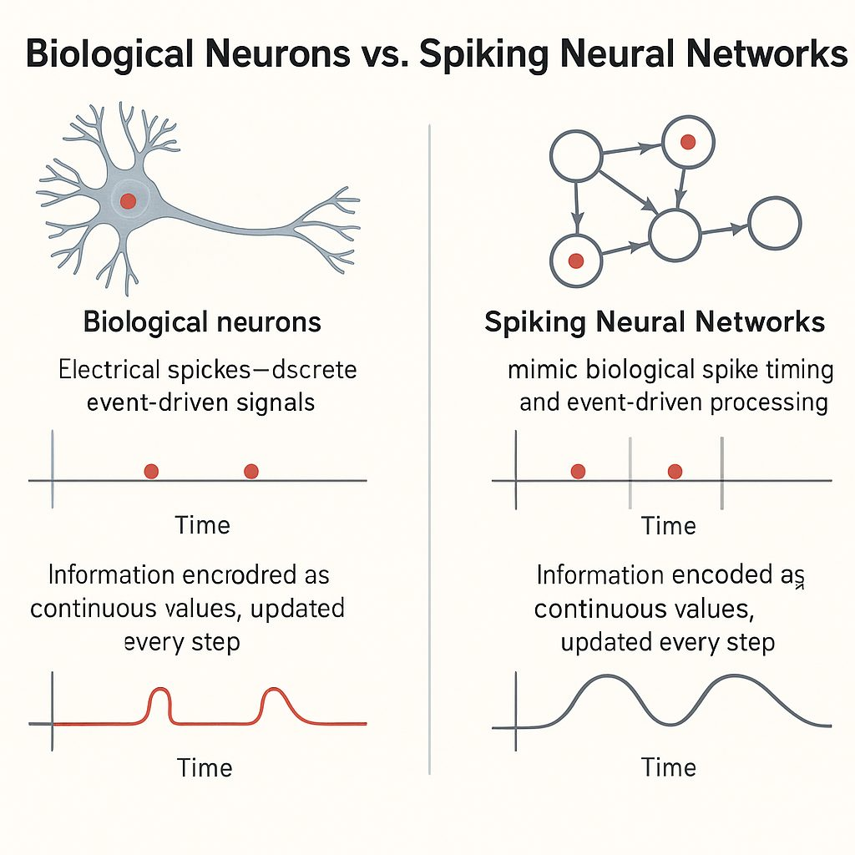
Spiking Neural Networks
Spiking Neural Networks are inspired by real neurons (more so than ANN neurons)
Spiking Neurons communicate in pulses (shown to the right)
There are many Spiking Neuron models, the two that were used to test obSTAtten were LIF and PLIF neurons
Image Source: https://aicompetence.org/spiking-neural-networks-on-fpga-speed-efficiency/

Slide 7

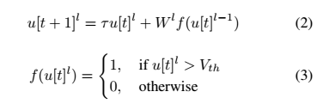
Leaky Integrate-and-Fire Neuron Model
T: Timestep
V(t) / u[t]: Current Membrane Potential
V_{rest}: Resting Membrane Potential
X(t): Current Neuron Input
𝜏: Membrane Time Potential (Leak Rate)
W: Weight
l: Referenced Layer

Slide 8
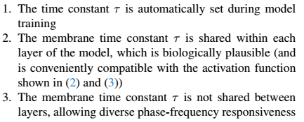
Parametric LIF Neuron
The parameter 𝜏 is no longer a hyperparameter and is treated as a trainable parameter
𝜏 is typically shared across an entire layer
This gives the network better temporal response than typical LIF models
PLIF neurons are defined by the three behaviors shown to the right

Slide 9
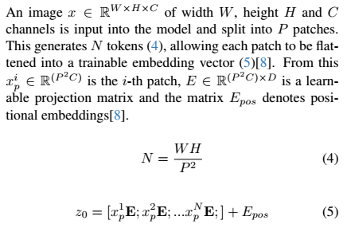
Vision Transformer (ViT)
When an image is fed into the model, the ViT splits it into P patches.
Different heads that train to correlate for Q, K, and V (Query, Key, Value)
Transformers allow non-contiguous regions of input data to be contextually correlated
Correlation is done using an attention model

Slide 10
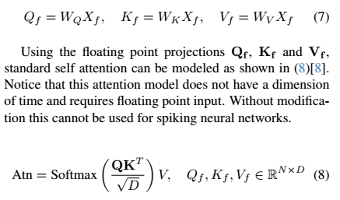
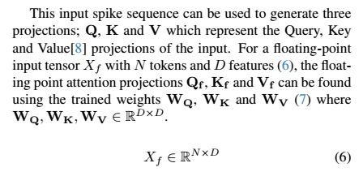
Standard Self Attention

Slide 11
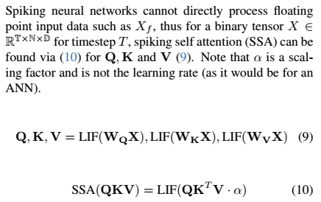
Spiking Self Attention
Spiking Self Attention (SSA) here is defined for an LIF neuron of arbitrary 𝜏
This attention model can be tested with both LIF and PLIF neurons

Slide 12
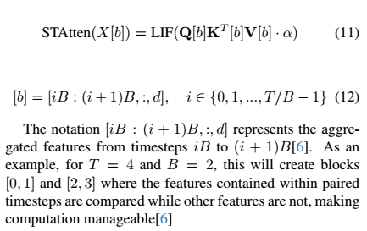
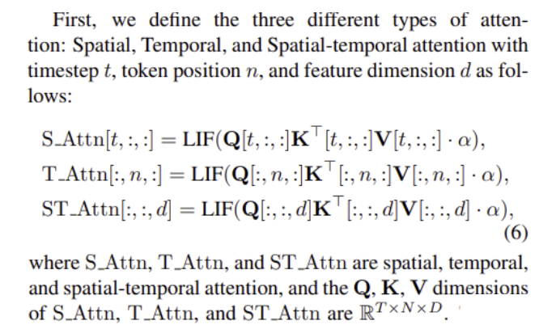
Spiking Transformer with Spatial-Temporal Attention

Slide 13
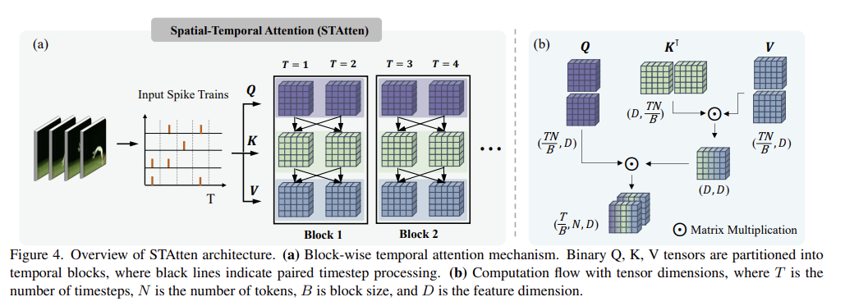
Spiking Transformer with Spatial-Temporal Attention

Slide 14
3. Proposed Approach

Slide 15
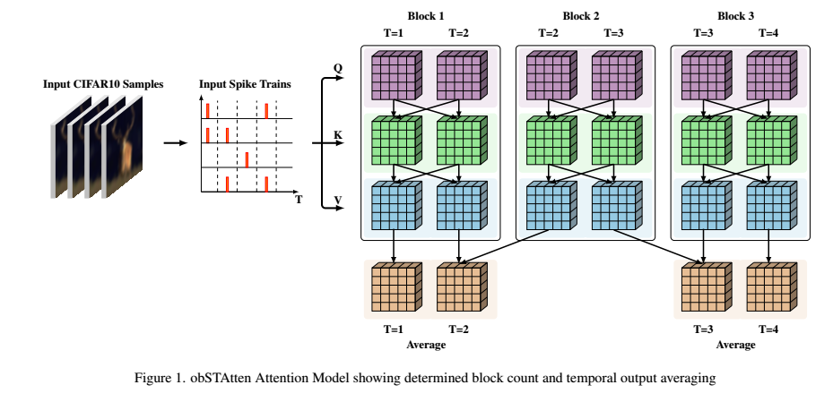
obSTAtten Architecture Concept

Slide 16
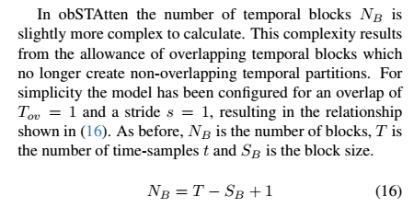
obSTAtten Change 1: Determining Block Count

Slide 17
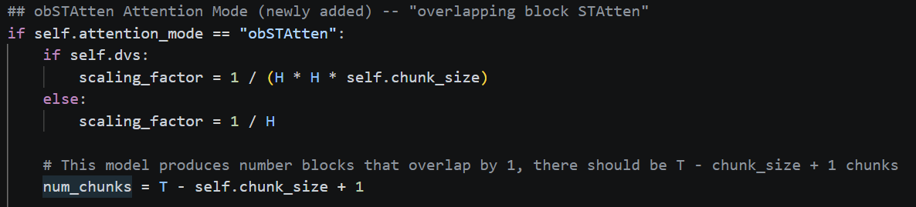
obSTAtten Change 1: Determining Block Count

Slide 18


obSTAtten Change 2: Overlapping Block Construction

Slide 19
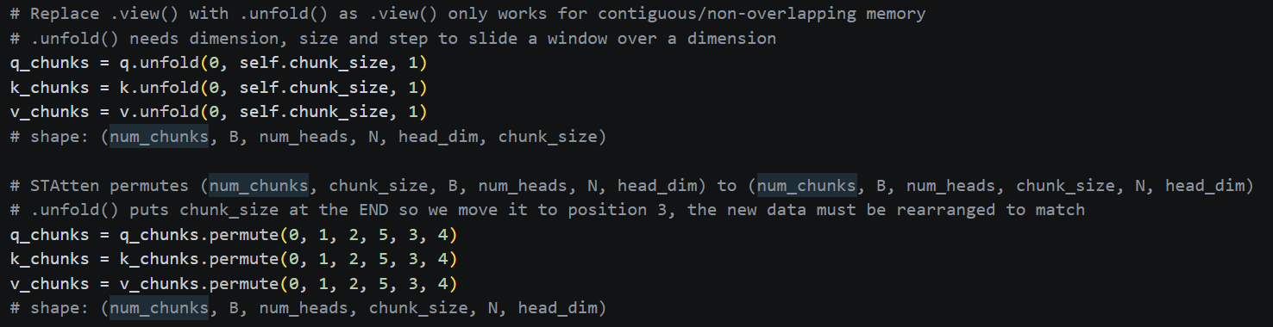
obSTAtten Change 2: Overlapping Block Construction

Slide 20
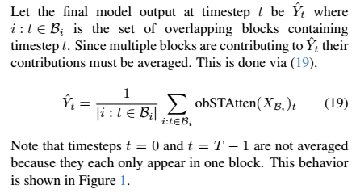
obSTAtten Change 3: Timestep Averaging

Slide 21
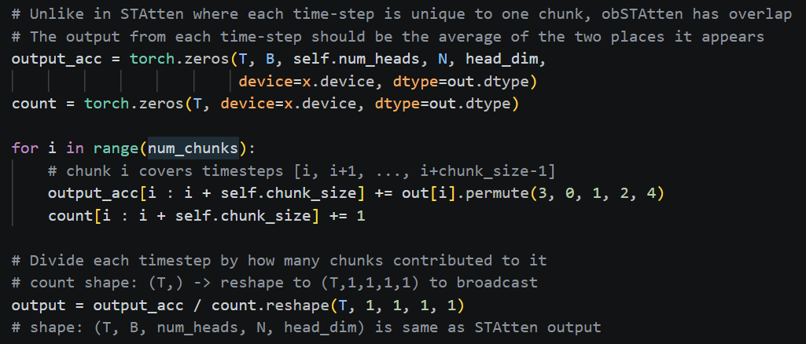
obSTAtten Change 3: Timestep Averaging

Slide 22
4. Experiment

Slide 23
Running the Training Pipeline
Spike Modes: lif, plif
Attention Modes: SDT, STAtten, obSTAtten
Dimension Sizes: 256, 512
(see -c conf/cifar10/2_512_200E_t4.yml \ )
Command Example:
torchrun --nproc_per_node=1 train.py \
-c conf/cifar10/2_512_200E_t4.yml \
--model sdt \
--spike-mode lif \
--attention_mode STAtten \
--batch-size 4

Slide 24
Limitations
Hardware:
GTX 1070 TI GPU (very old)
Limits batch size to 4
~100 GB of HDD space on the system (not enough to run CIFAR10-DVS)
Would sometimes run out of space mid-run
Time:
Each run takes ~20-30 hours, this means I could only do 1-2 runs each 48 hours. I did not have time to make any more data, however I managed to test 12 scenarios over the course of this project.

Slide 25
5. Results

Slide 26
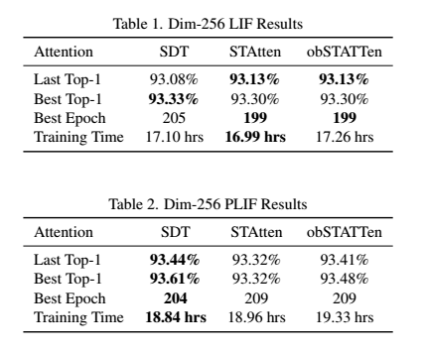
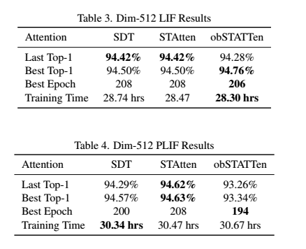
Tabular Results

Slide 27
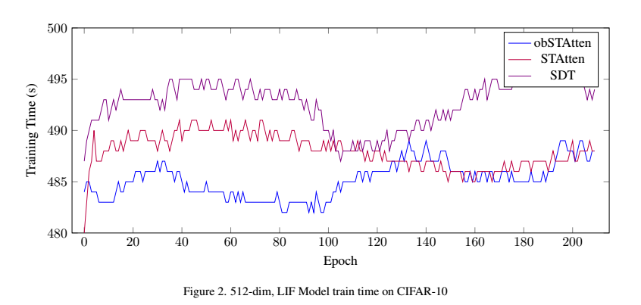
512-dim, LIF, Training Times per Epoch

Slide 28
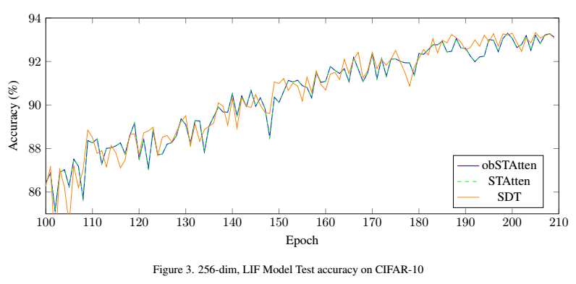
256-dim, LIF, STAtten obSTAtten Convergence

Slide 29
Other Observations
LIF vs PLIF on obSTAtten Performance
Both STAtten and obSTAtten perform worse relative to SDT for PLIF
The extra temporal information may confuse PLIF (which already has temporal information)
The extra temporal information seems to help LIF (which does not have as much temporal information)
STAtten vs obSTAtten for Best-Epoch
In both dim-512 cases obSTAtten reaches its peak faster than STAtten does
This happens both for LIF (when obSTAtten does better) and PLIF (when STAtten does better)

Slide 30
5. Conclusion

Slide 31
Conclusion
Limitations and Shortcomings
The paper only explored the effect of CIFAR10 with static images, which likely limited obSTAtten’s ability to express unique some behaviors
SNNs are inherently temporal and I would like to continue experimenting with this using DVS
obSTAtten only conditionally outperforms STAtten, but it does (in some cases) outperform STAtten
Future Work
The paper proposes two directions for future work depending on hardware constraints:
Explore more stride and overlap options for CIFAR10 and similar settings
Invest in better equipment and study the effects of DVS on the current obSTatten

Slide 32
Questions?

